Slide 1
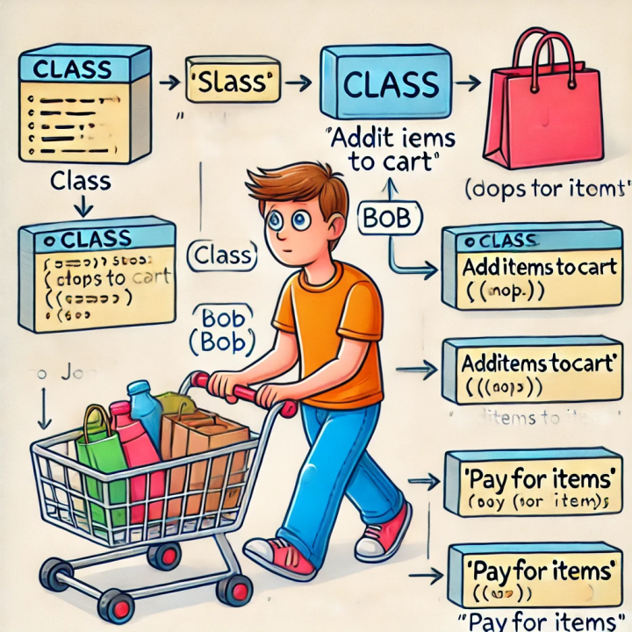
INVENTORY MANAGEMENT SYSTEM

Slide 2
TEAM MEMBERS
SAMARTH CHAND THAKURI
SHOURYA SHARMA
PRATIK KAUSHAL
Group-12

Slide 3
Problem Statement for Inventory Management System
Managing inventory is a critical task for businesses, including retail stores, warehouses, and manufacturing units. Traditional inventory management methods, such as manual record-keeping or spreadsheet-based tracking, are inefficient, error-prone, and time-consuming. This often leads to problems like stock shortages, overstocking, mismanagement, and revenue loss.

Slide 4
Objective of the Inventory Management System Project
The main objective of developing an Inventory Management System (IMS) is to efficiently manage stock levels, reduce operational costs, and streamline inventory tracking. The system ensures real-time visibility of stock, minimizes errors, and optimizes the supply chain process.

Slide 5

OVERVIEW OF AN INVENTORY MANAGEMENT SYSTEM
An Inventory Management System (IMS) is a software or process that helps businesses track and manage their stock, supplies, and materials efficiently. It ensures that products are available when needed while minimizing excess inventory, reducing costs, and improving overall efficiency.

Slide 6

Key Features of an Inventory Management System
Stock Tracking: Monitors the quantity of products in real time.
Barcode & QR Code Scanning: Speeds up inventory updates and reduces errors.
Order Management: Automates purchase orders and sales tracking.
Supplier & Vendor Management: Keeps track of supplier details and order history.
Demand Forecasting: Uses historical data to predict future inventory needs.
Multi-location Management: Manages stock across different warehouses or stores.
Alerts & Notifications: Sends alerts for low stock levels or overstocking.
Reports & Analytics: Provides insights into sales, stock levels, and trends.
Integration with ERP & Accounting Systems: Syncs with financial software for better tracking.
User Access Control: Assigns roles and permissions to different users.

Slide 7

The system includes the following components:
Item: Represents products in the inventory with properties like id, name, price, quantity, and supplier.
Supplier: Represents vendors that provide items to the inventory.
User (abstract): Base class for system users with common properties.
Admin: Can add/remove items from inventory.
Staff: Can create and process orders.
Order: Represents a purchase order with multiple items.
OrderItem: Represents a line item in an order.
Inventory: Manages the collection of items with methods for adding, removing, and searching.
InventoryManagementSystem: Main class that demonstrates the system's functionality.
The main class demonstrates creating suppliers, items, users, adding items to inventory, creating and processing orders, and checking inventory status.

Slide 8
Literature Review / Similar Work
Inventory Management Systems (IMS) have evolved significantly with the advent of modern computing technologies. A variety of solutions—ranging from traditional desktop-based applications to cloud-enabled platforms—have been developed to streamline inventory tracking, ordering, and supply chain operations.
1. Traditional Inventory Management Systems: Earlier IMS implementations were often desktop-based, developed using languages such as C++ or Java, focusing on local database storage (e.g., MS Access, SQLite). These systems primarily addressed small-scale inventory needs with limited multi-user capabilities.
2. Enterprise-Level IMS (SAP, Oracle NetSuite): Modern enterprise-grade systems like SAP Inventory Management and Oracle NetSuite offer advanced features including automated reordering, multi-location support, real-time analytics, and seamless ERP integration. These systems are highly scalable but come at a significant cost and complexity.
3. Open-Source Solutions: Open-source inventory systems such as Odoo, ERPNext, and inFlow Inventory provide flexible and cost-effective alternatives. These are often web-based and include modules for purchase, sales, inventory, and customer relationship management. They are typically built using Python (Odoo), JavaScript, or PHP, and rely on web technologies for their UI.

Slide 9
This inventory management system demonstrates several key OOP concepts:
Inheritance: The User class serves as a base class with common properties and methods, while Admin and Staff are specialized subclasses that inherit from it.
Abstraction: The User class is abstract with an abstract method getRole() that must be implemented by subclasses.
Encapsulation: All classes use private fields with public getters and setters to control access to their data.
Polymorphism: The system uses polymorphic behavior through the User hierarchy, allowing different user types to be treated uniformly where appropriate.
Composition: The system uses composition relationships (e.g., Order contains OrderItem objects, Item references a Supplier).

Slide 10
01
THE SYSTEM INCLUDES THE FOLLOWING COMPONENTS:
02
ITEM: REPRESENTS PRODUCTS IN THE INVENTORY WITH PROPERTIES LIKE ID, NAME, PRICE, QUANTITY, AND SUPPLIER.
03
SUPPLIER: REPRESENTS VENDORS THAT PROVIDE ITEMS TO THE INVENTORY.
CURRENT STATUS
04
USER (ABSTRACT): BASE CLASS FOR SYSTEM USERS WITH COMMON PROPERTIES.
05
ADMIN: CAN ADD/REMOVE ITEMS FROM INVENTORY.
06
ORDER: REPRESENTS A PURCHASE ORDER WITH MULTIPLE ITEMS.
07
ORDERITEM: REPRESENTS A LINE ITEM IN AN ORDER.
07
INVENTORY: MANAGES THE COLLECTION OF ITEMS WITH METHODS FOR ADDING, REMOVING, AND SEARCHING.
09
INVENTORYMANAGEMENTSYSTEM: MAIN CLASS THAT DEMONSTRATES THE SYSTEM'S FUNCTIONALITY.

Slide 11

1. DATABASE INTEGRATION
2. EXPAND CLASS HIERARCHY
3. ADDITIONAL FEATURES
4. GUI DEVELOPMENT

Slide 12
CONCLUSION & KEY POINTS
The development of the Inventory Management System (IMS) using JavaFX demonstrates the practical application of object-oriented programming, UI design, and database integration in solving real-world business problems. This project effectively showcases how desktop-based inventory systems can be designed with modern interfaces and modular architecture, offering an accessible solution for small to medium-scale enterprises.
The system’s role-based access (admin, supplier, user), CRUD functionality, and database-driven design make it a reliable tool for managing inventory operations. JavaFX provided a flexible and responsive UI framework, while the use of DAOs and MVC pattern ensured maintainability and separation of concerns.

Slide 13
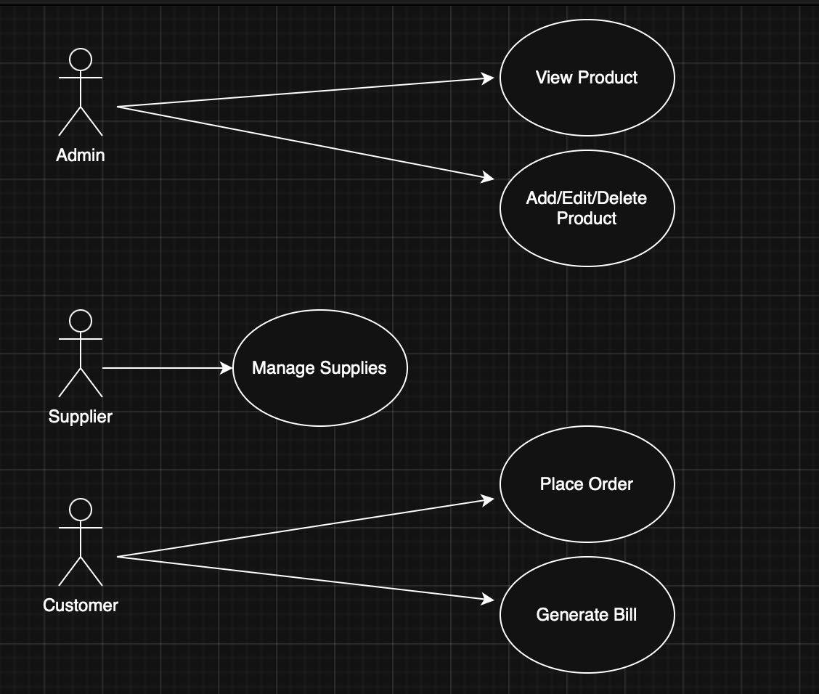
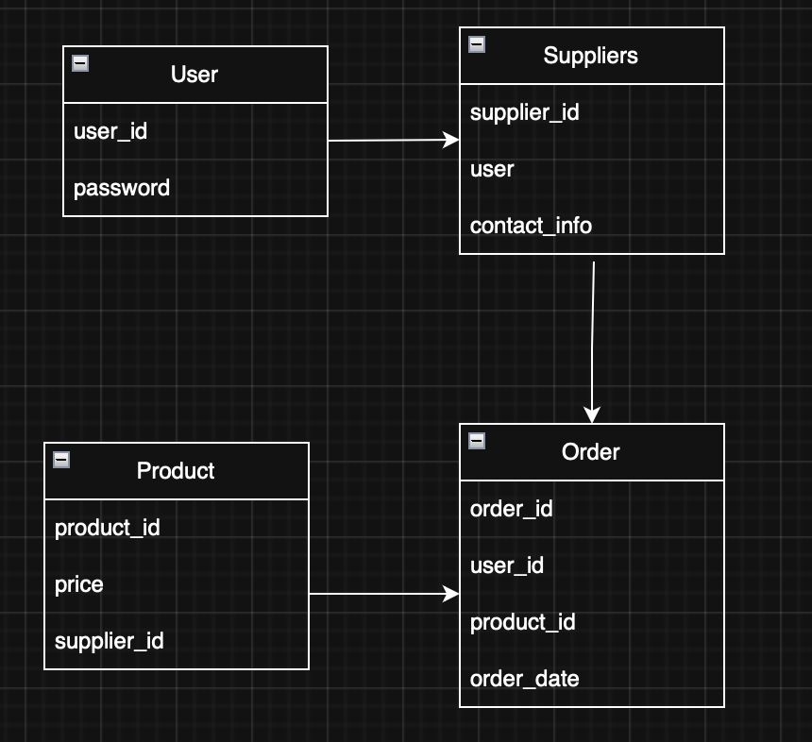
USE CASE AND DATABASE DIAGRAM

